Slide 1
Group 8
Level 4/5 Group 8: Petrut Vasile, Sorin Cristea, Louis Vagner

Slide 2
Brief
LV
Choose a game genre
Change of a core mechanic
Single player Game
Intuitive gameplay
Notes:
In the brief we received, we had to produce a single player game in a total of 12 weeks. We needed to choose a genre and change one basic core mechanic while keeping the gameplay as intuitive as possible.

Slide 3
Solution to the Brief
PV
RogueLike
No Perma-death
Solution : body switch with the killer
Notes:
A RogueLike game is characterized by a dungeon crawl through procedurally generated levels, turned-based gameplay, tile-based graphics and permanent death of the player character.
We took off the permanent death mechanic and decided instead that the player can never die. If your player loses against an enemy, you then take control of that enemy.

Slide 4
Mechanics
LV
Procedurally generated dungeon
Point and click movement & combat
Matching mechanic
Notes:
To stick with the RogueLike genre we have procedurally generated dungeon that creates infinite rooms for the player
and we implemented a point and click movement to keep a gameplay as easy as possible.
The rooms of our dungeon are divided between six different biomes that are all separated with a special door that can only be destroyed by a capacity of a specific enemy.
That is our matching mecanic.

Slide 5
Dynamics
SC
Exploration
Combat
Looting

Slide 6
Aesthetics
SC
Easy fun
Sense of accomplishment
Wonder

Slide 7
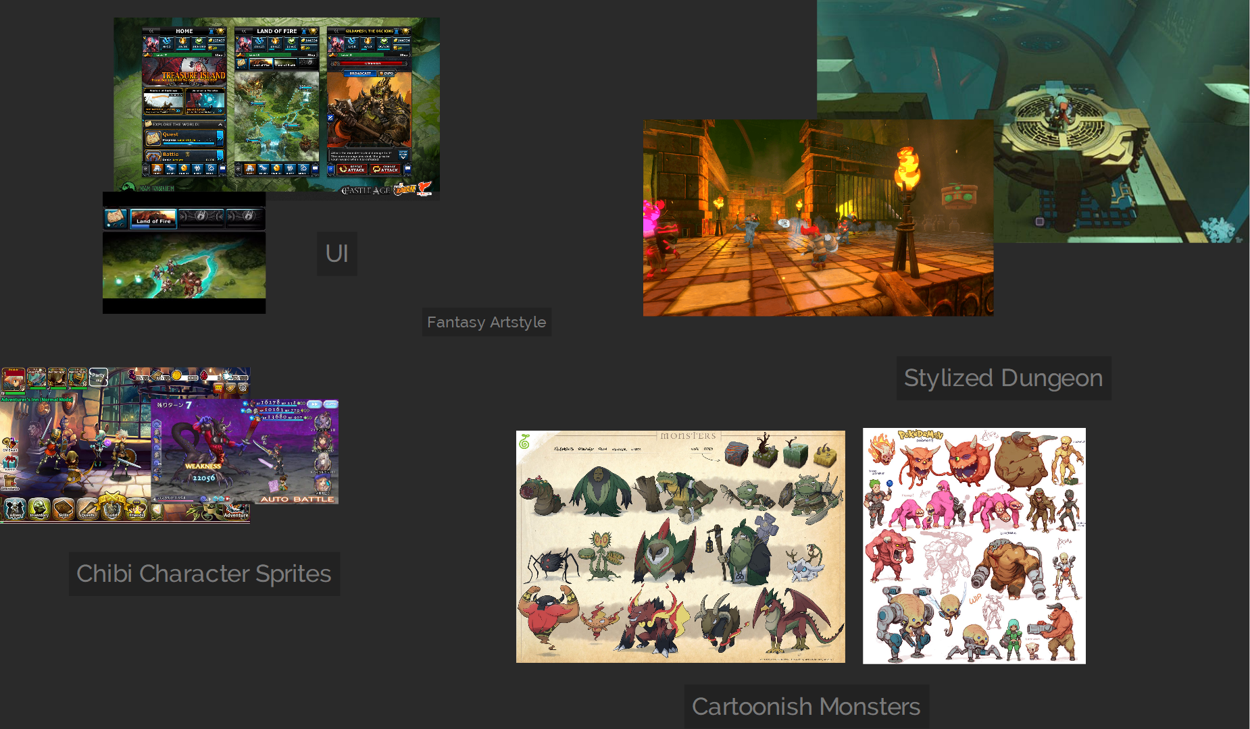
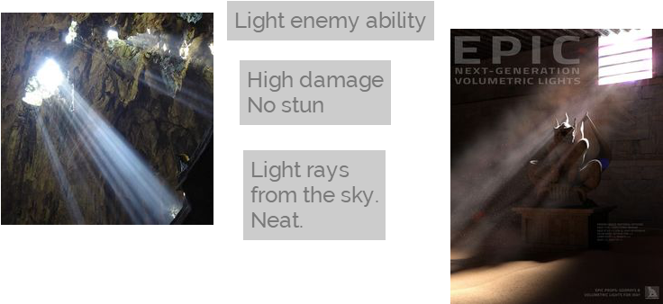
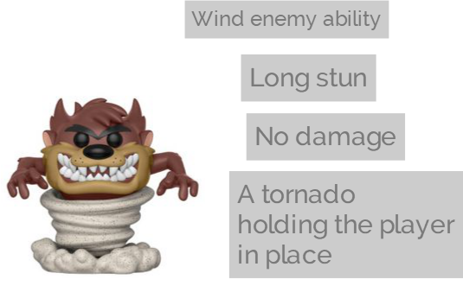
Moodboards
SC

Slide 8
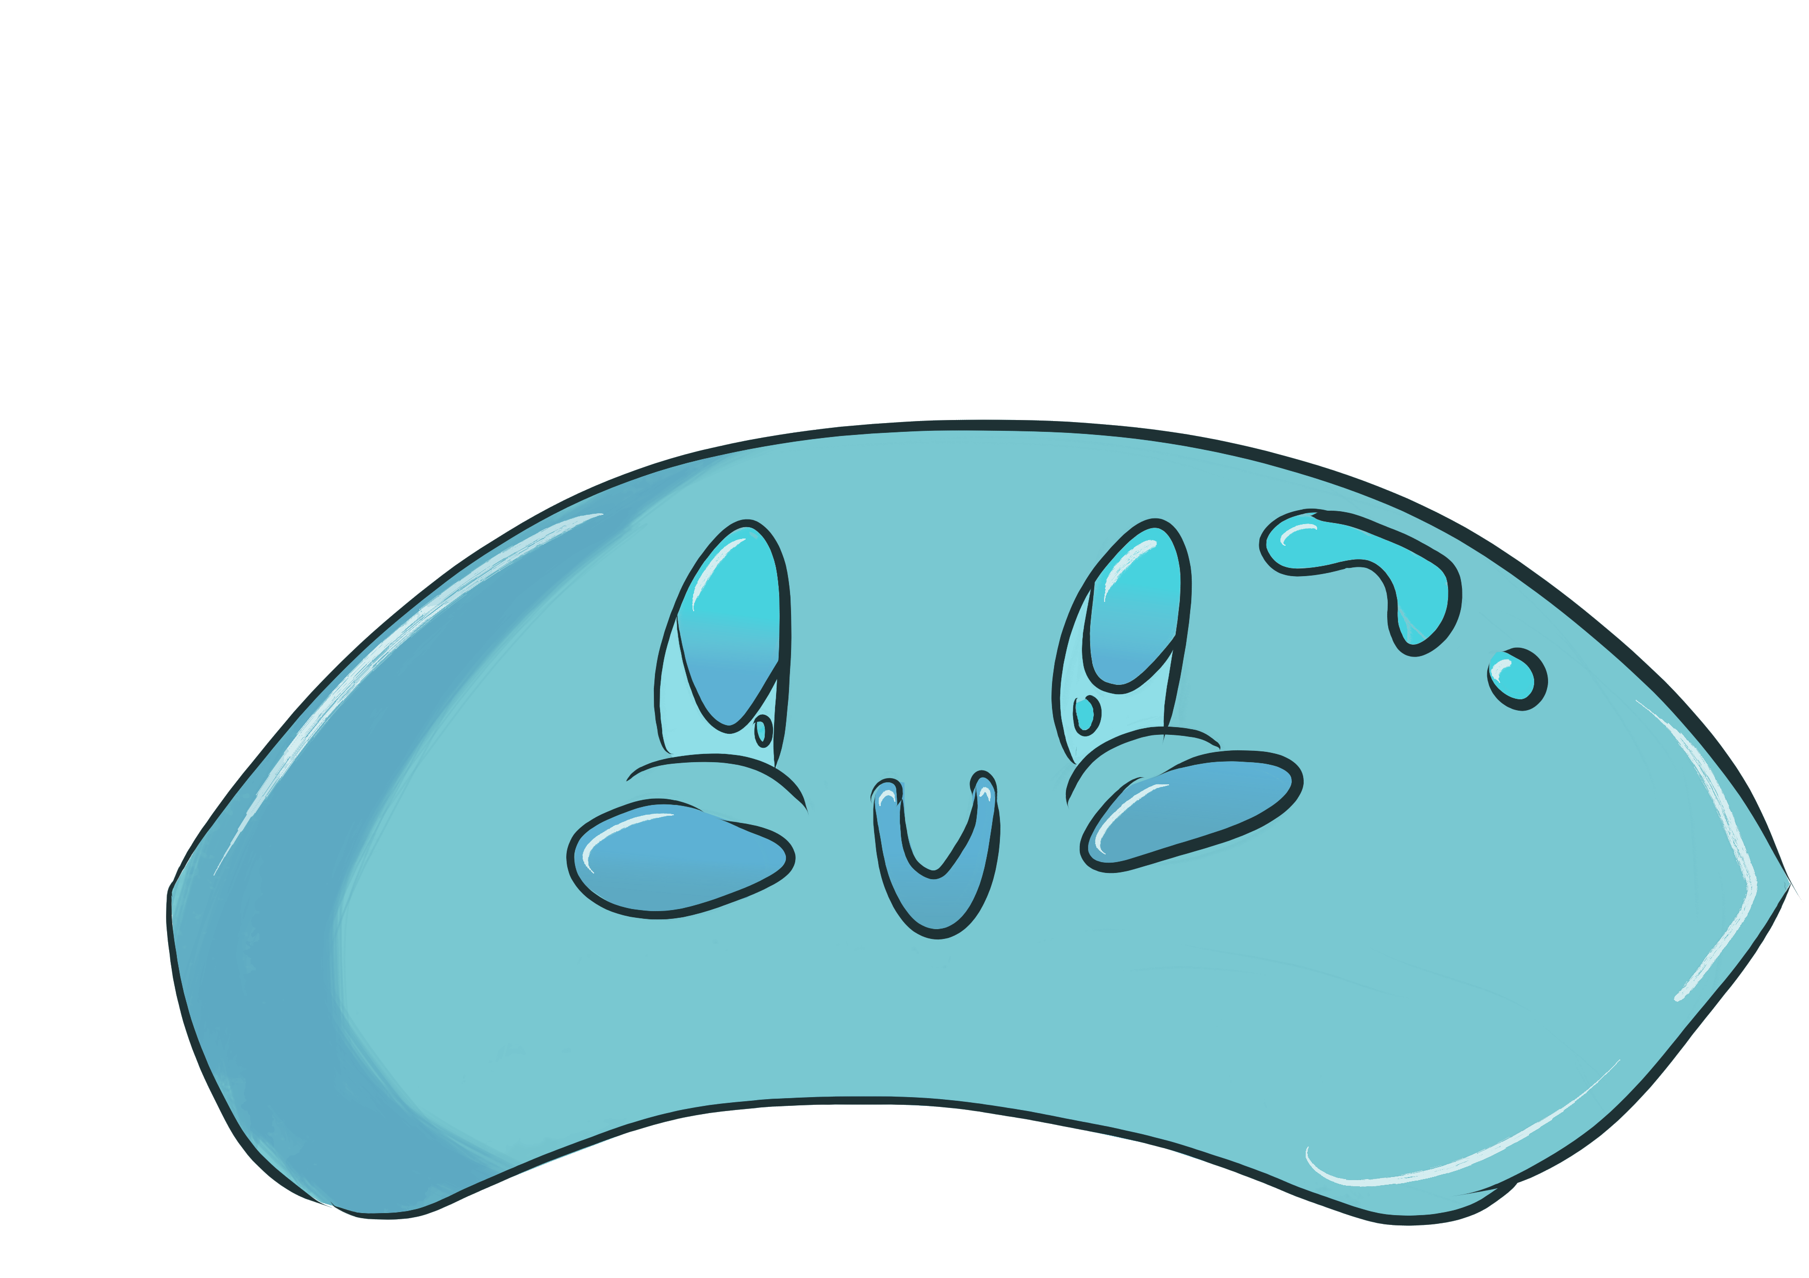


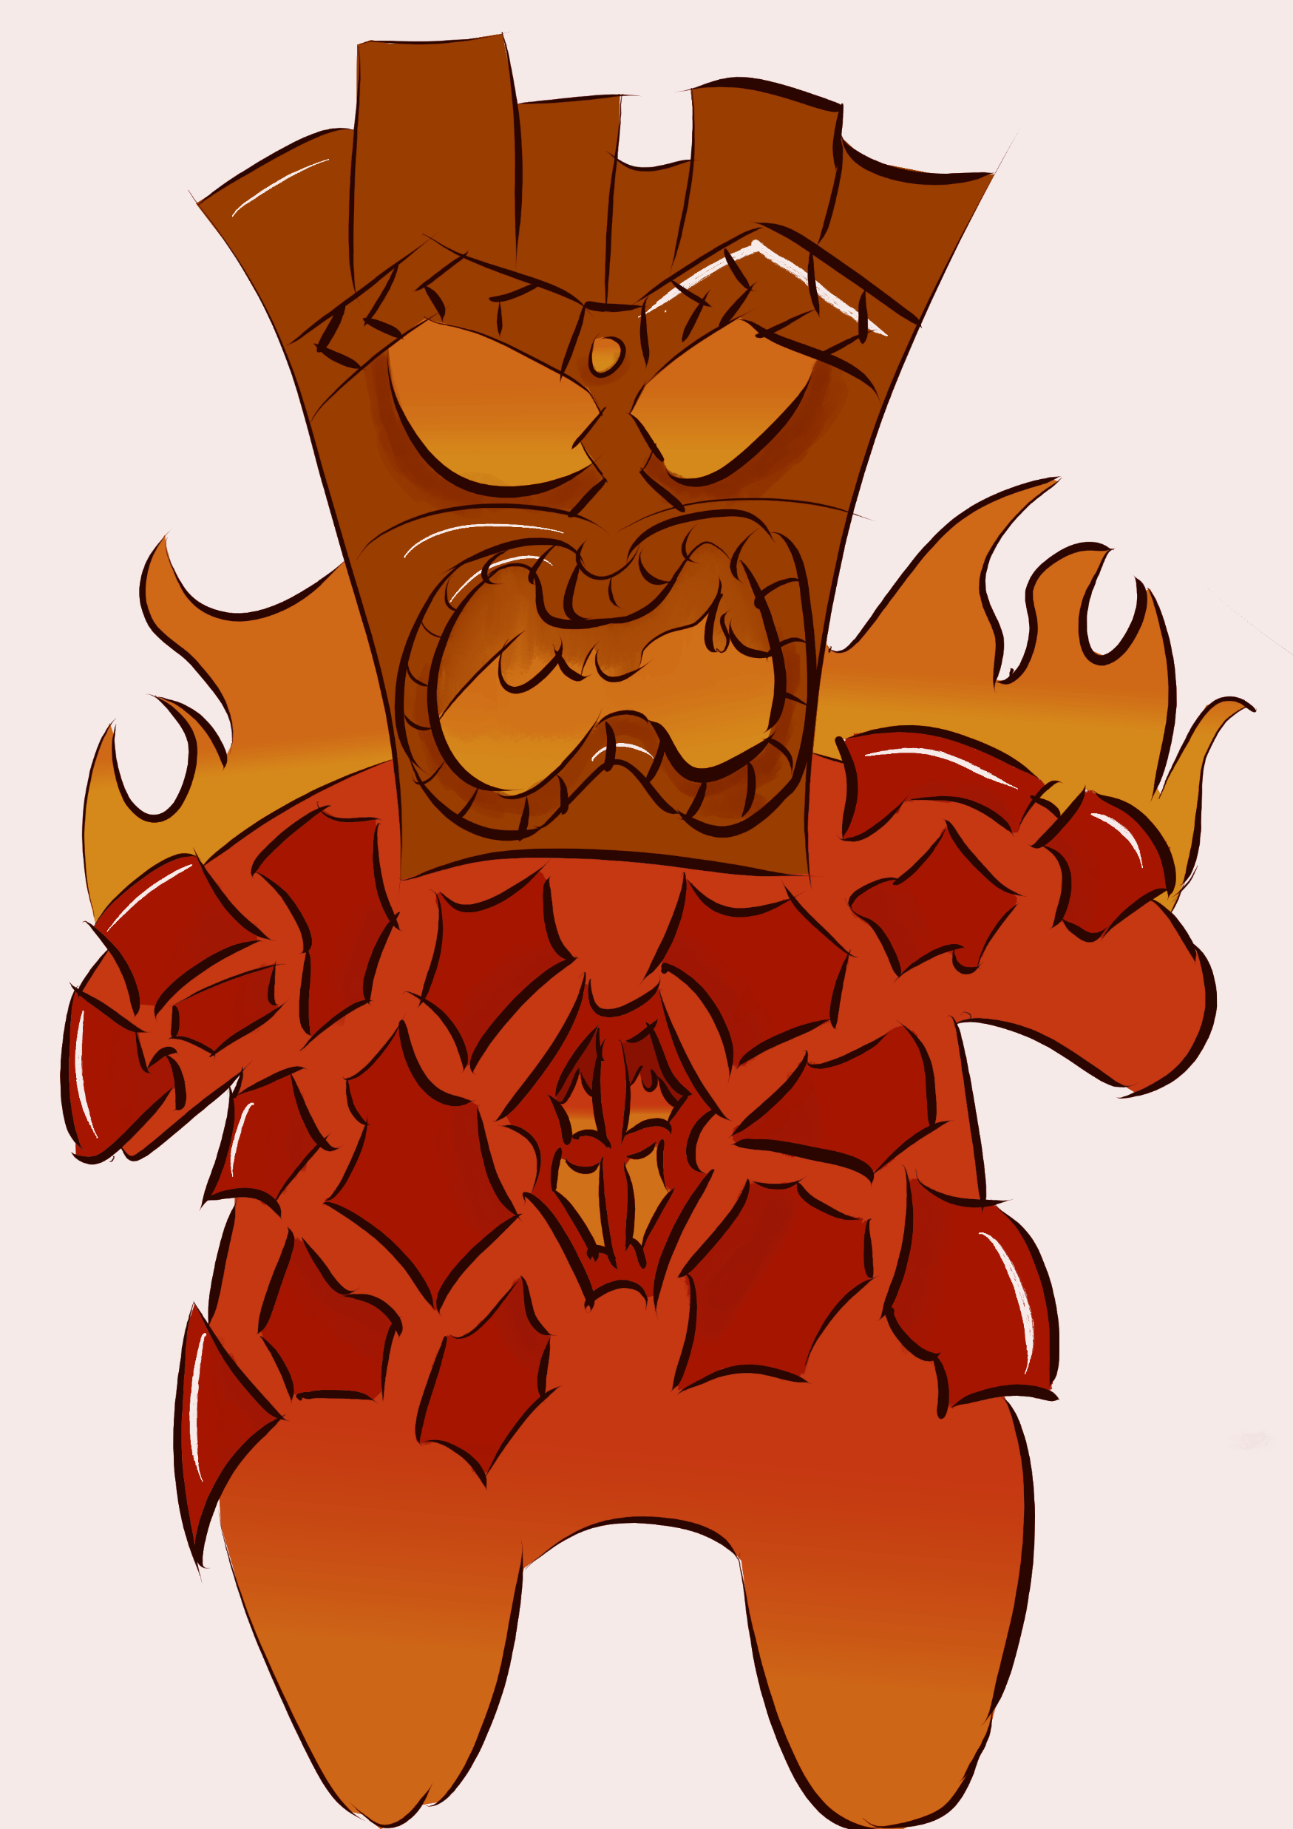
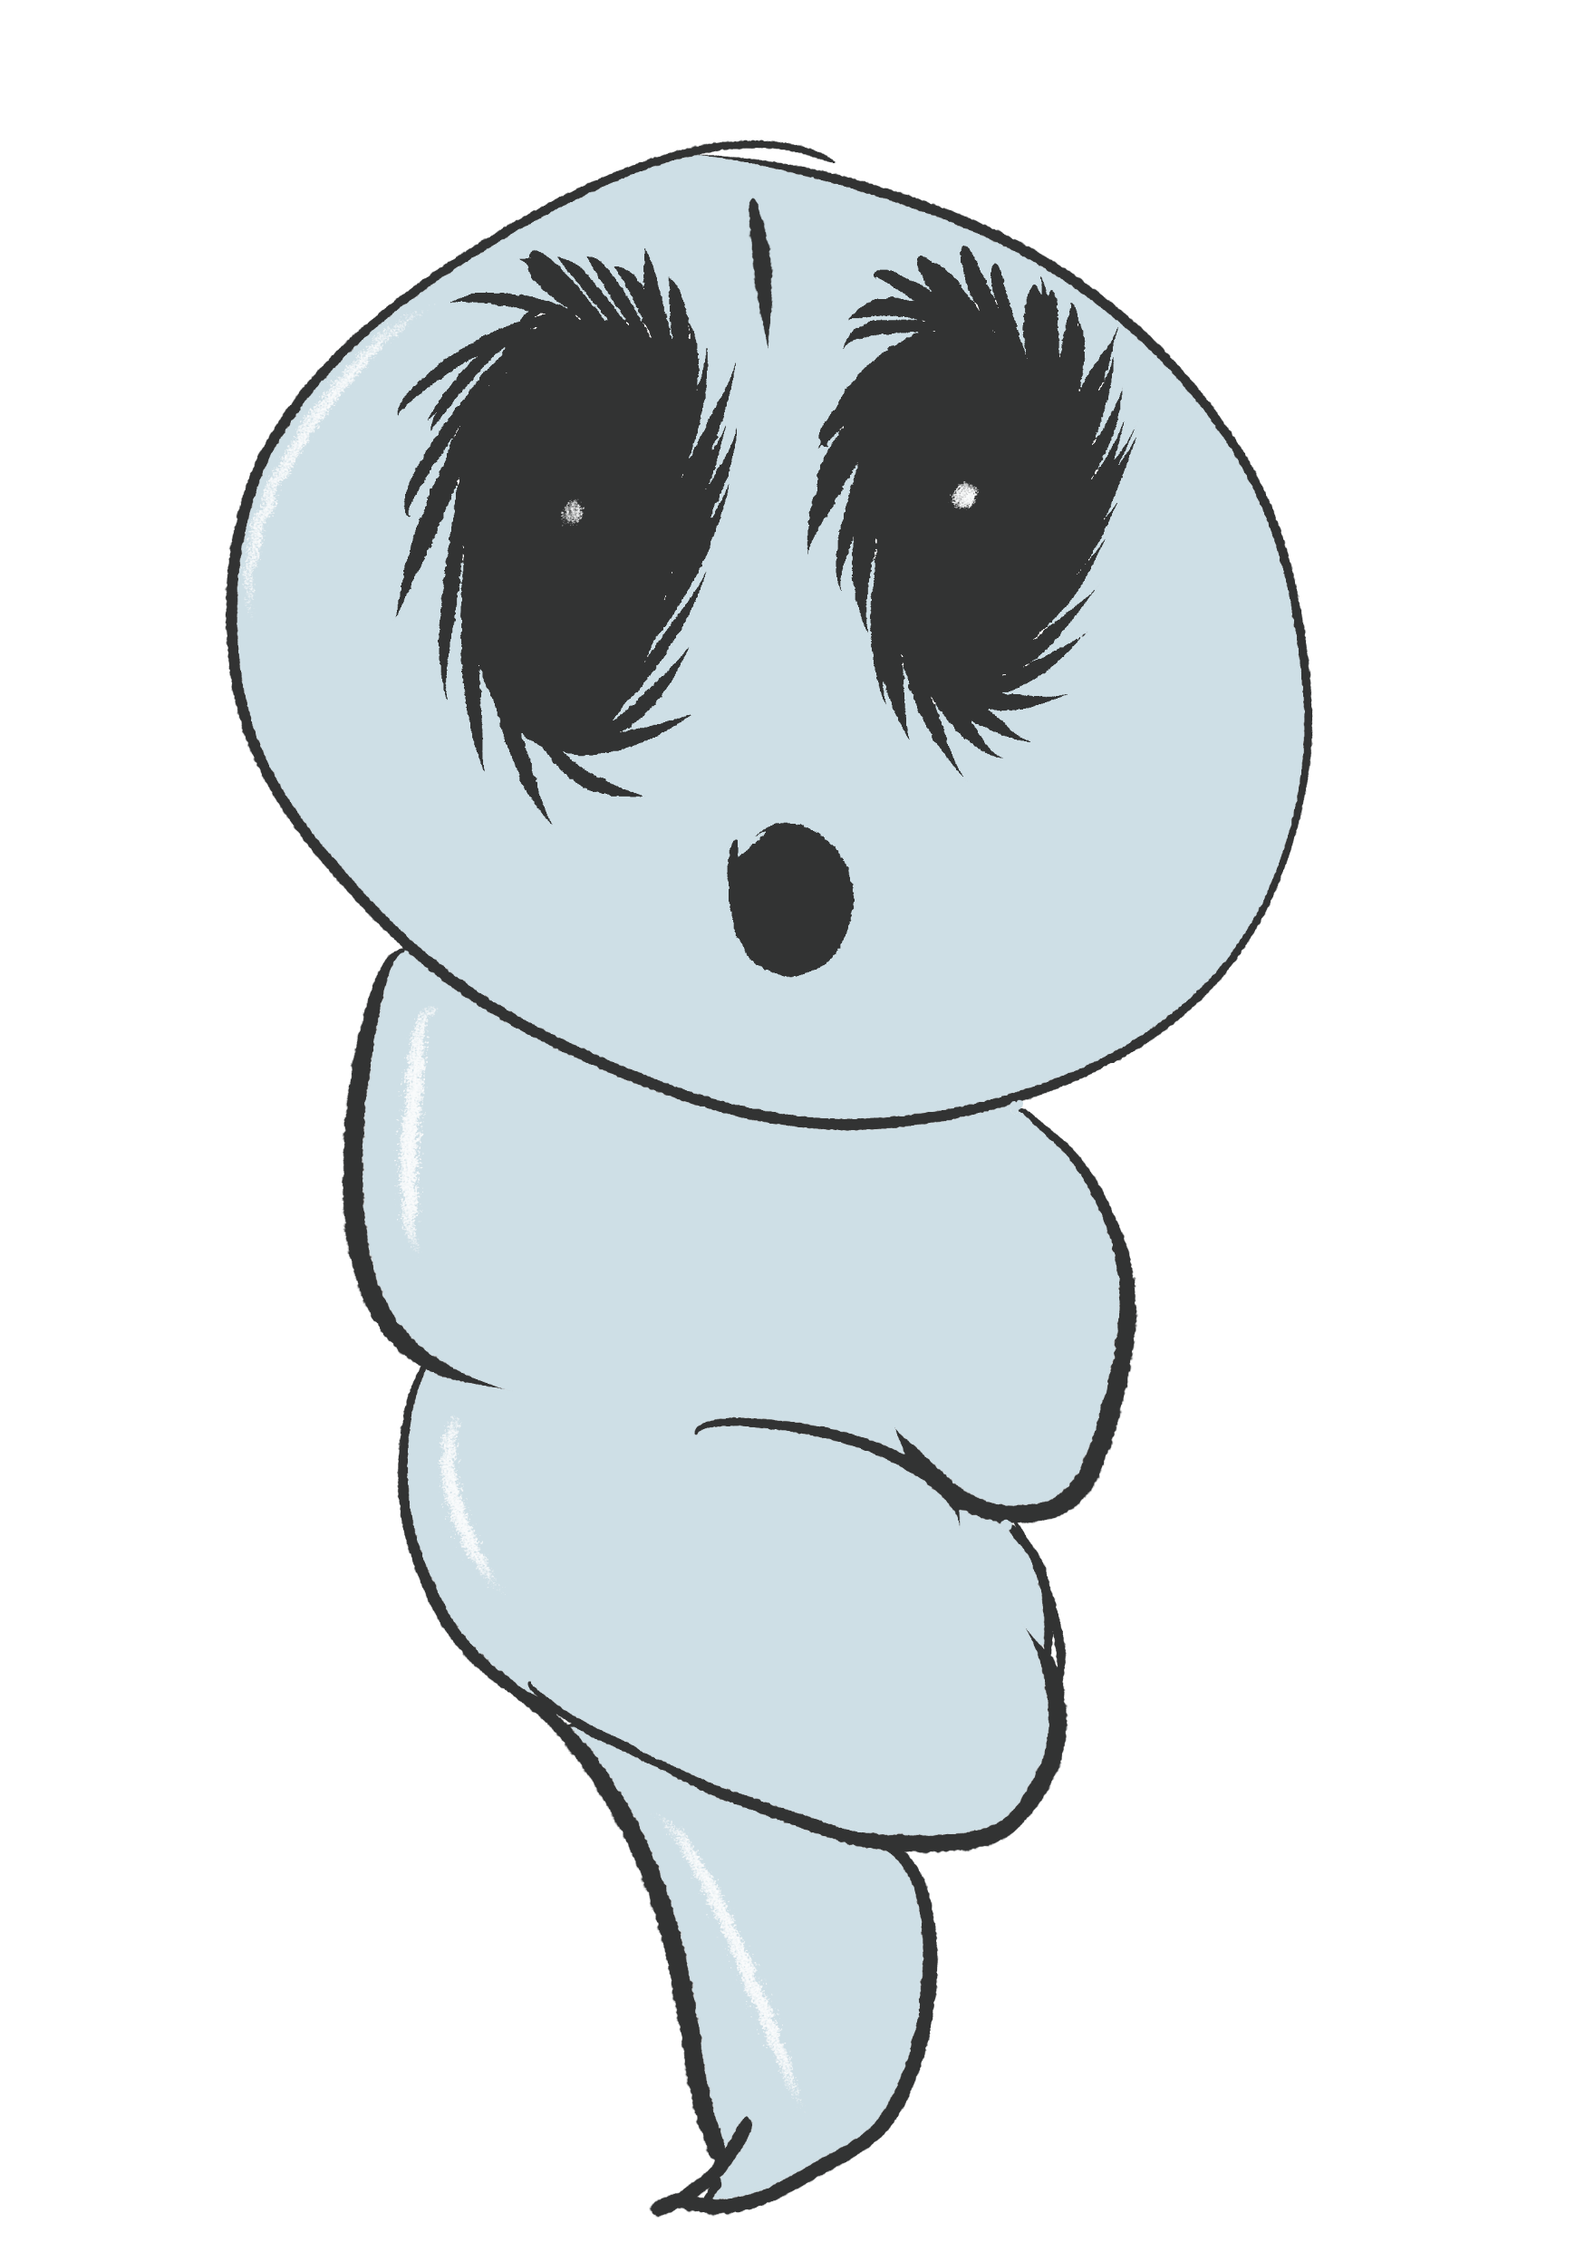
Art
SC

Slide 9
Walkthrough
PV

Slide 10
The following weeks
PV
Implementing narrative items
Creating a tutorial level
Testing
Balancing
Polishing

Slide 11
Questions?

